Slide 1
Predicting across all US households
http://faraday.io Seamus Abshere, CTO

Slide 2
My talk
2013: defining moment
2017: what have we learned?
Future doubts

Slide 3

Let me take you back to 2013…

Slide 4
Our new AI startup in 2013
Started at grandma’s beach house
Predicting future customers for biggest contractor in Massachusetts
Demanding buyers:
MIT signals engineer
University of Chicago econometrics PhD
Notes:
$100 million per year…. Larry loved asking for charts we’d never heard of

Slide 5
Our new AI startup in 2013
Deadline today
Support vector machines 💥 exploding
Servers melting
Millions of people not predicted yet…

Slide 6
Defining moment
Were we…
Tool experts? (fix the SVM, unmelt servers)
or
Domain experts? (focus on data and signal)
We chose to be domain experts.

Slide 7
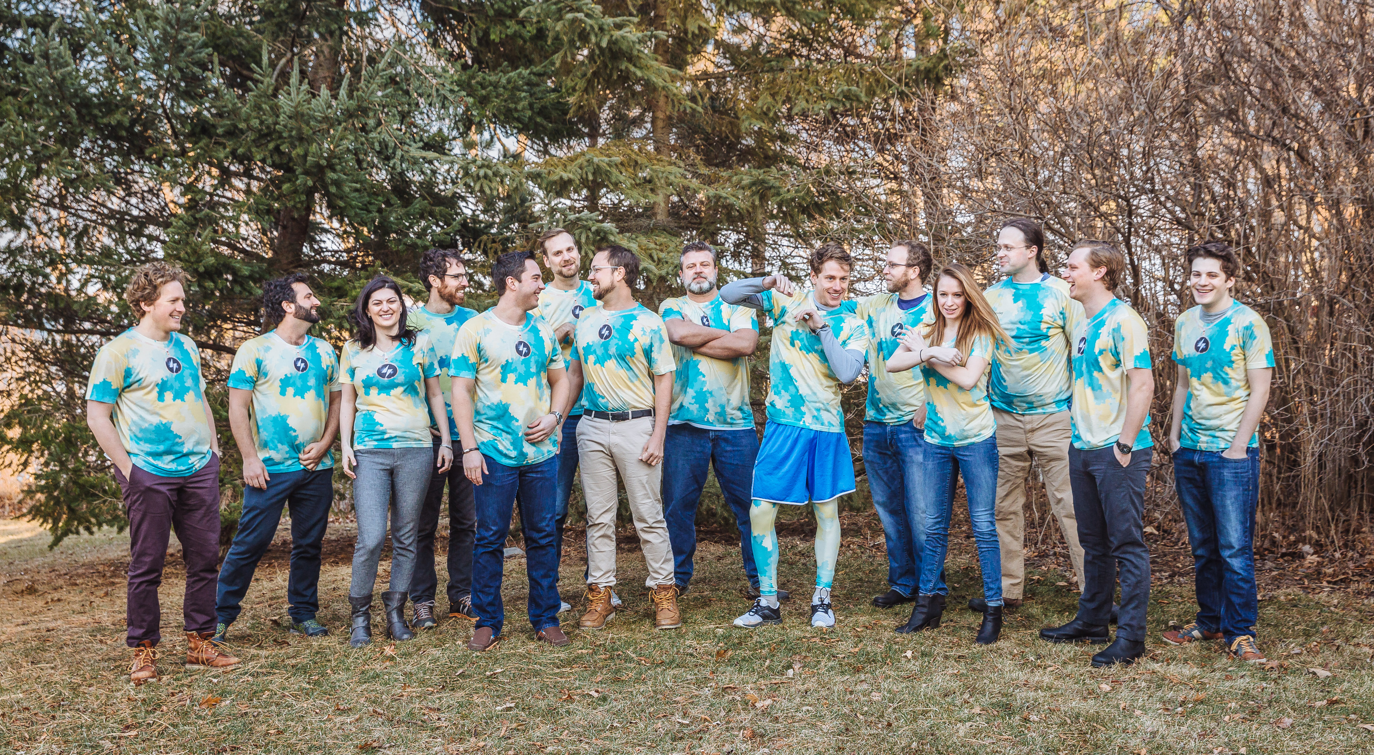
Bring us back to 2017

Slide 8
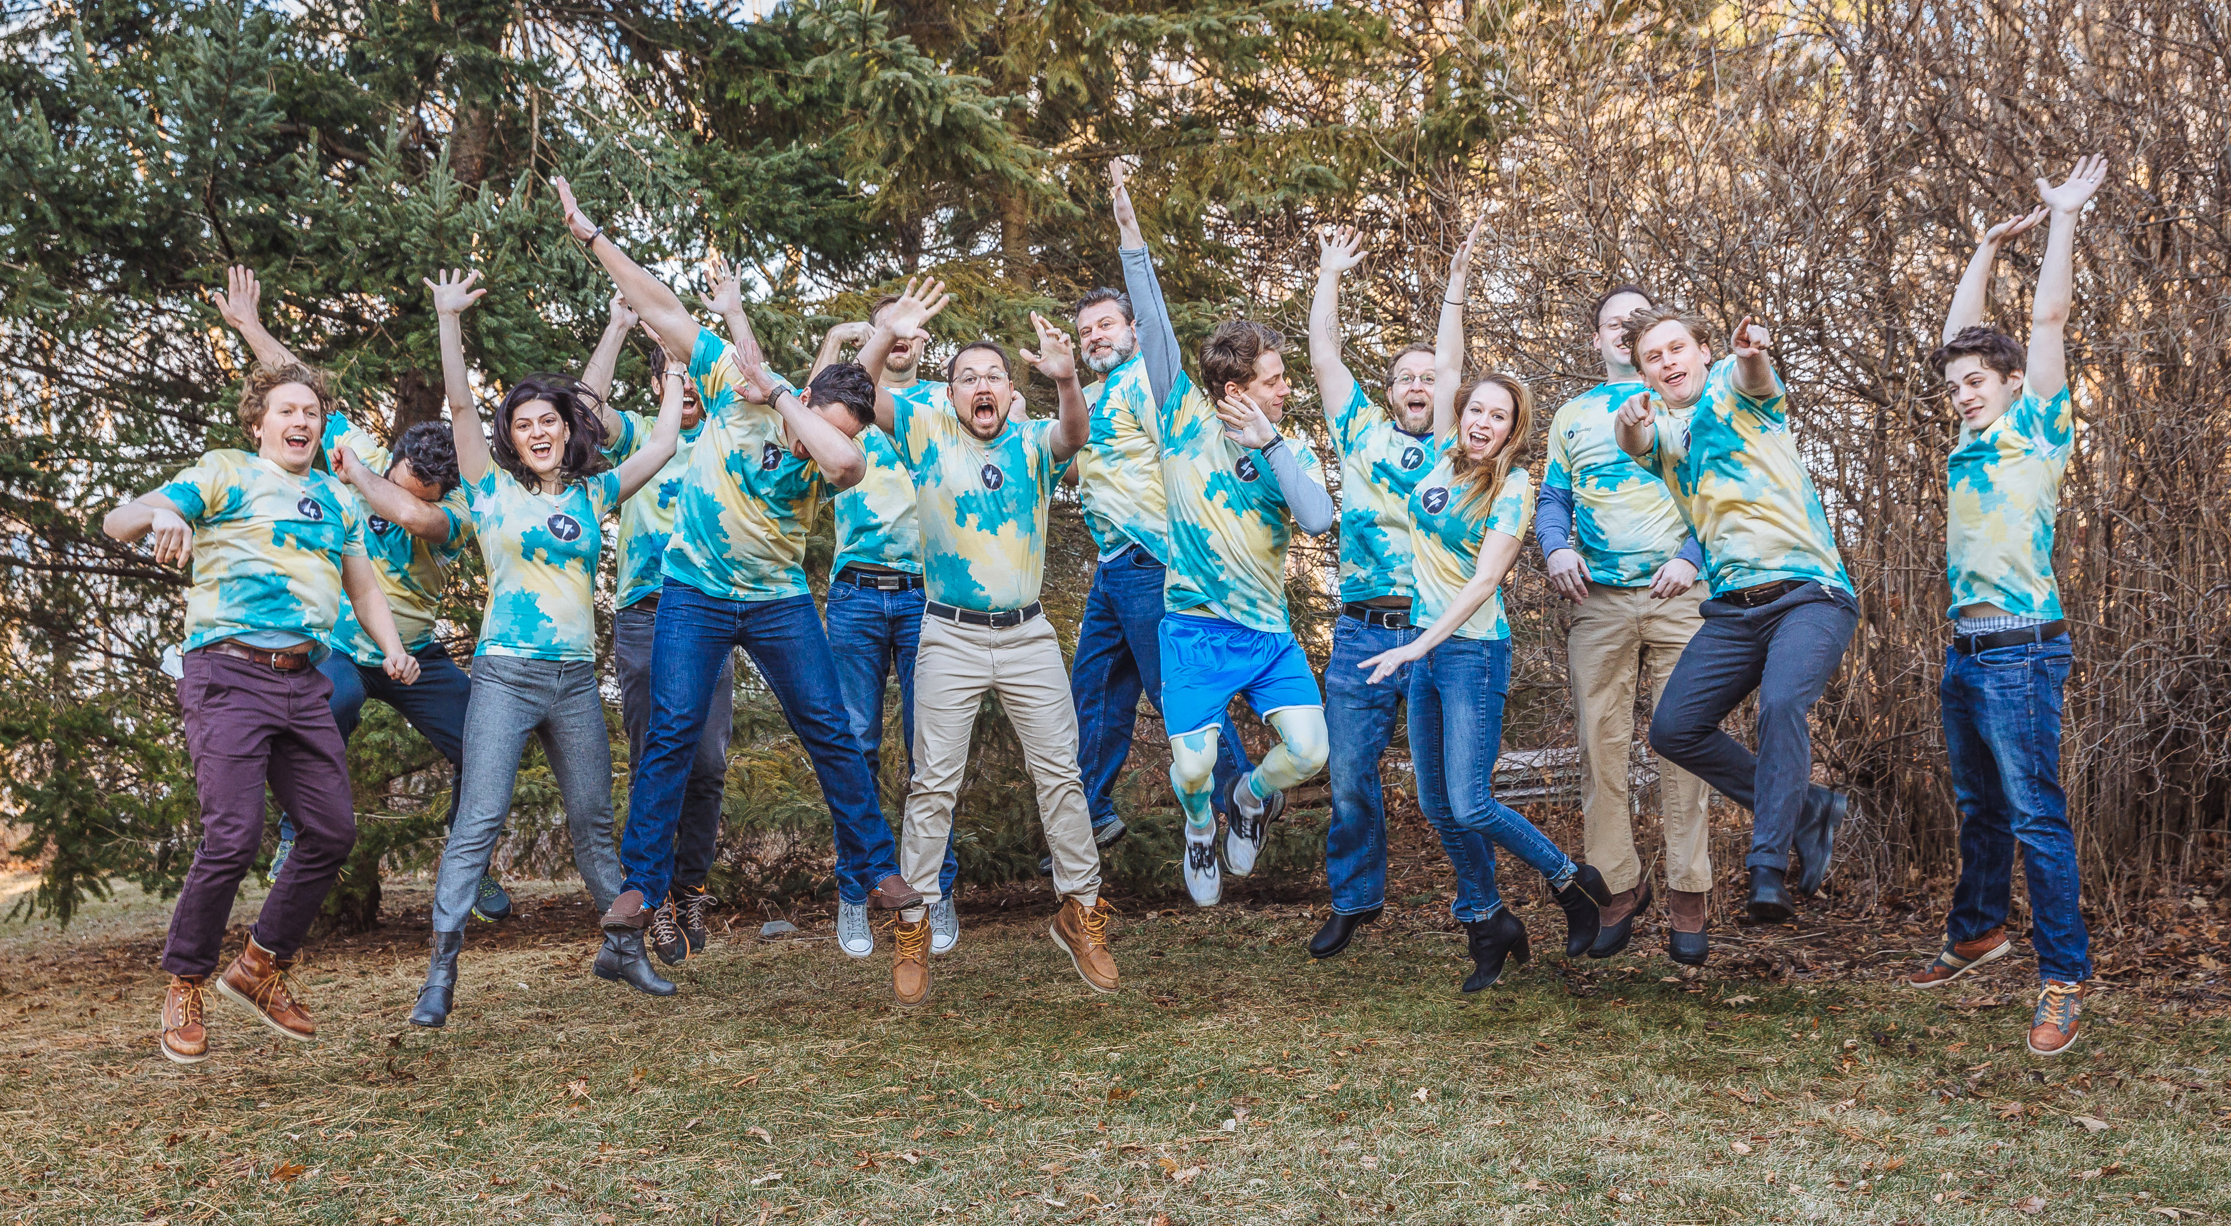
Bring us back to 2017

Slide 9
What have we learned?
Geocode everything
Postgres database
Outsource AI tools
Labels are secret sauce
Phi not accuracy
Watch for cheating
WhizzML is awesome
Notes:
How to predict across 250 features and 90 million rows? How to deal with extra data provided by customers?

Slide 10
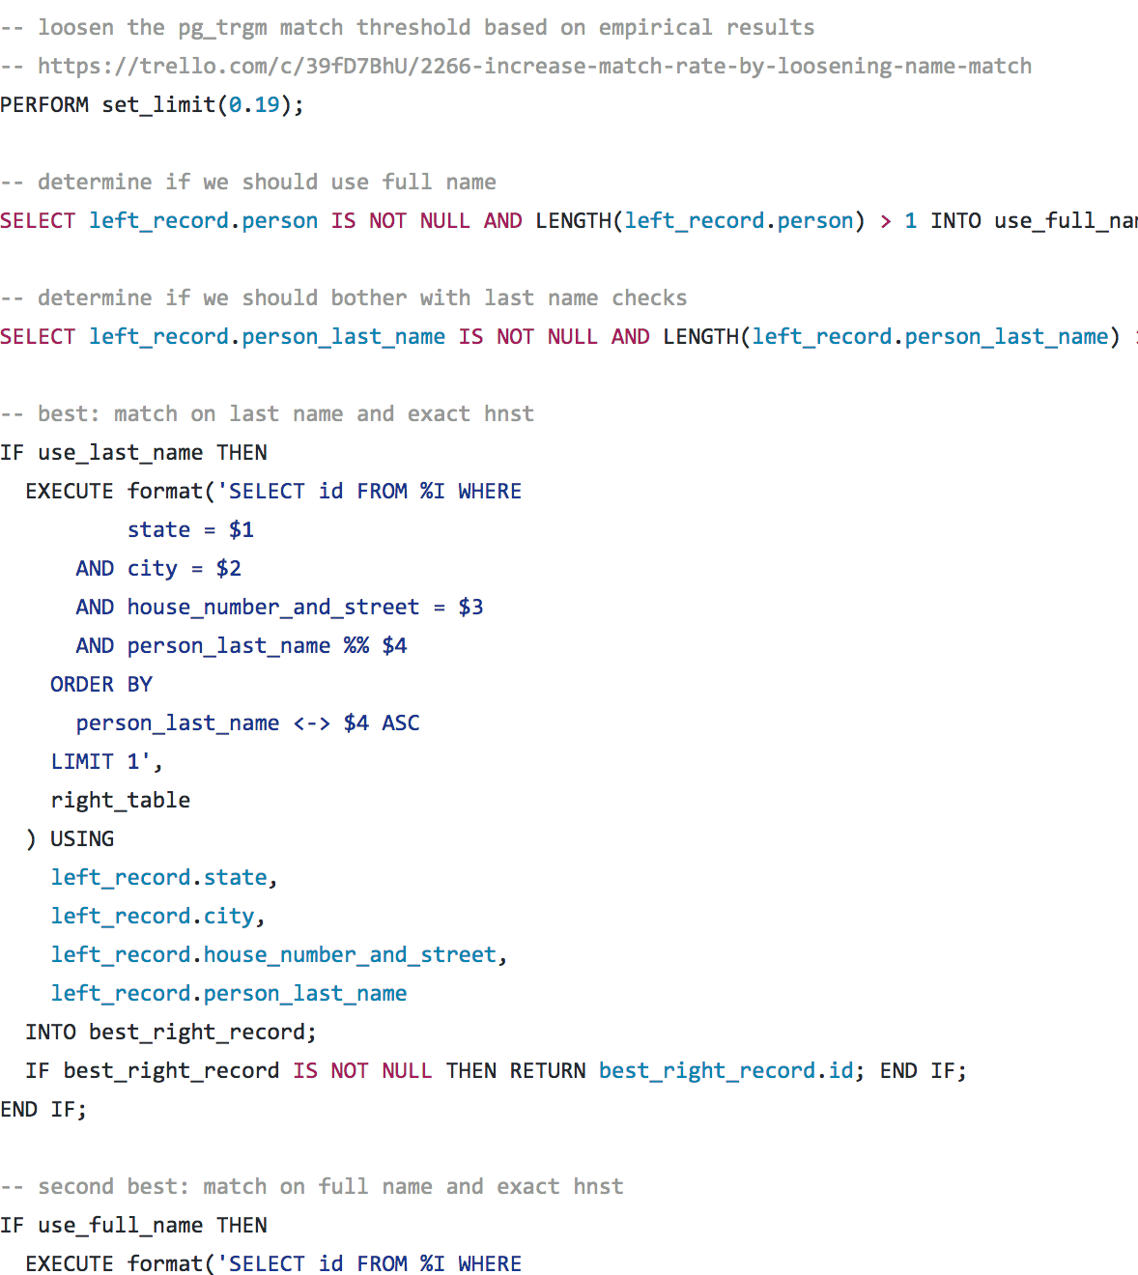
Geocode everything
Stay sane when you have multiple datasources
Before
Fuzzy match street
Pray lat/lons good 🙏🏽
After
Exact match street
Fuzzy match person
Don’t need lat/lon
Notes:
The more expensive a dataset, the crappier it is. Google is expensive, smartystreets is unlimited

Slide 11

Postgres database
Don’t mess with inferior databases
Before
MySQL, XLS, etc.
After
Best fuzzy matching
Best unstructured fields
Best CSV import/export
Best user-defined functions
🎉 SQL 🎉

Slide 12
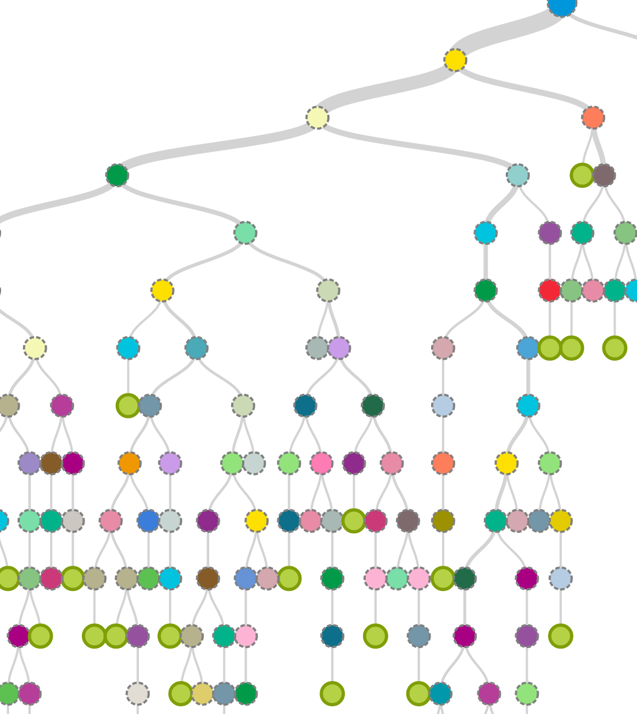
Outsource AI tools
We chose to be domain experts
Before
Scikit-learn in-house
Support Vector Machines (SVM)
After
BigML
Decision trees, whatever they recommend
Notes:
Tooling gets better every day, you could use all your energy just keeping up. Focus on your area of expertise!

Slide 13
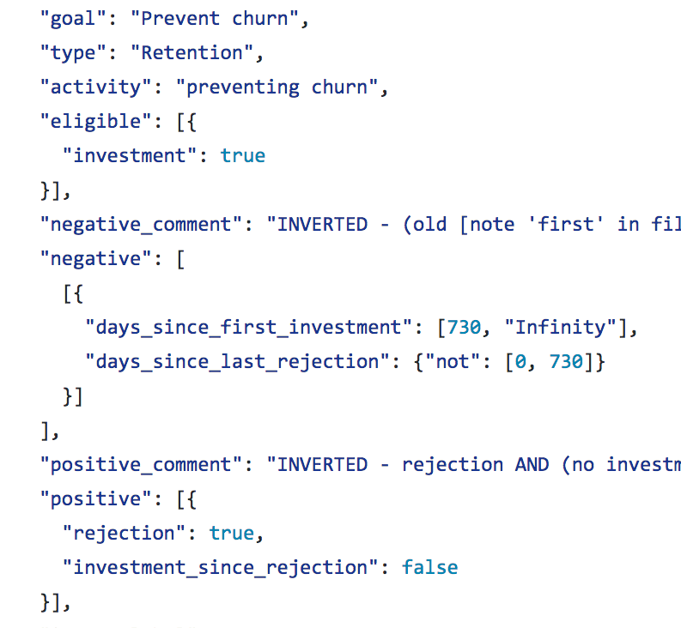
Labels are secret sauce
Opportunity for creativity and uniqueness
Before
Made purchase = good
Don’t call me back = bad
After
Per-client goals
Time- and sequence-based

Slide 14
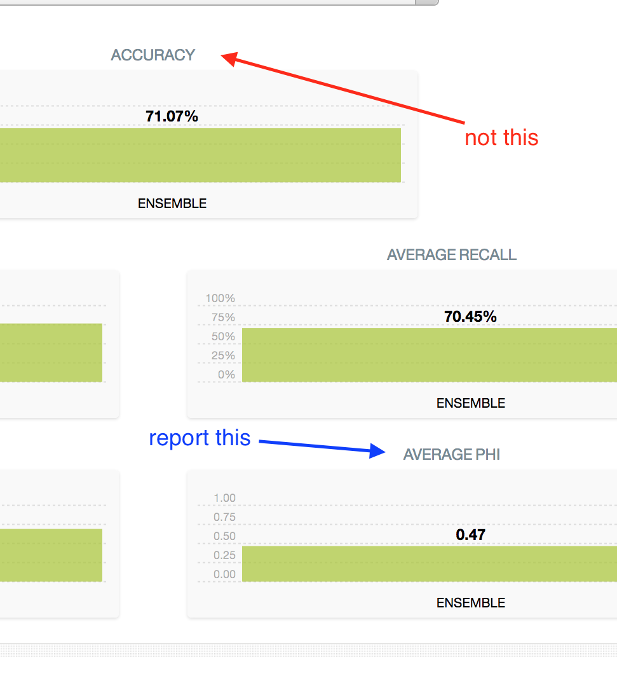
Phi not accuracy
Use meaningful metrics
Before
Accidentally reported training as test 😳
Accuracy
After
Automated train/test
Phi
Class balancing
Notes:
Use metrics that tell you if you’re really finding a signal

Slide 15
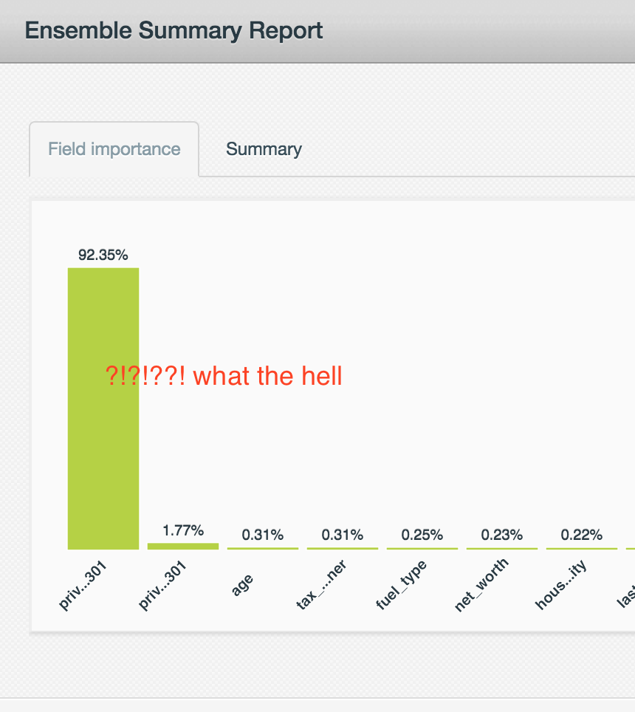
Watch for cheating
If a model is too good to be true, it probably is
Before
so distracted by tools we couldn’t focus on context
After
obsessive focus down to the feature level
Notes:
Paranoia is so important.

Slide 16
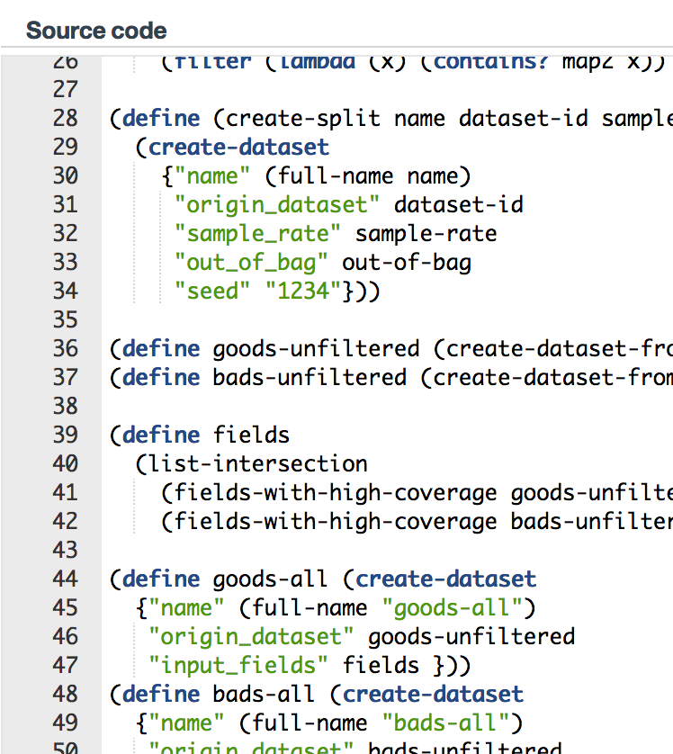
WhizzML is awesome
Make the hard network / scaling go away
Before
Polling HTTP
After
Single script

Slide 17
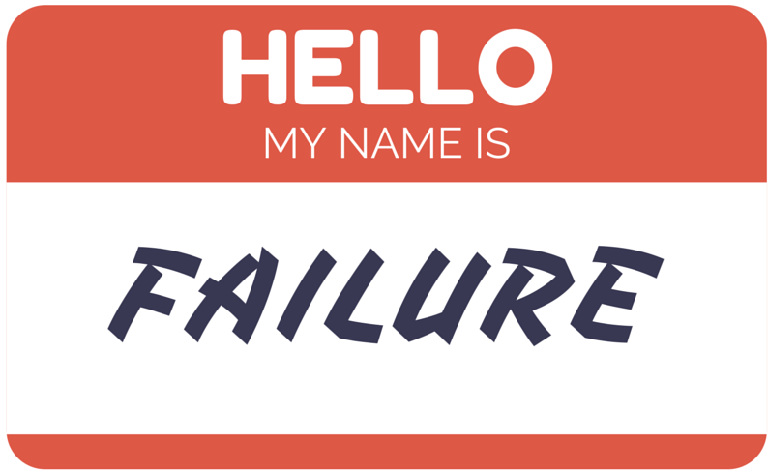
Future doubts

Slide 18
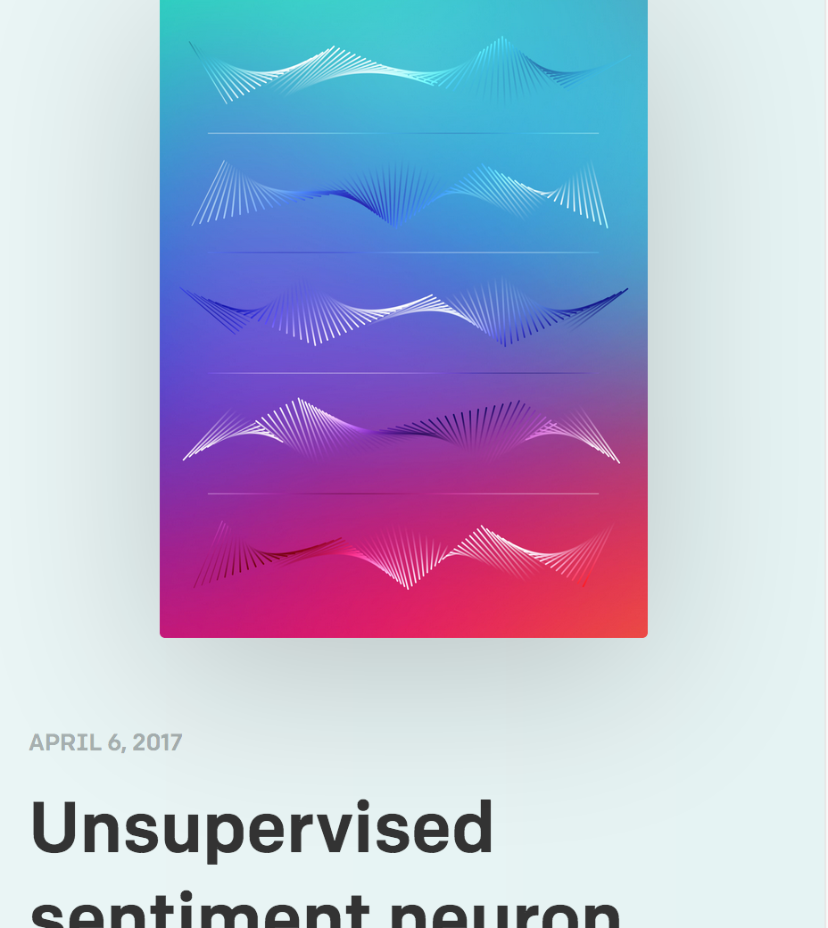
Convolutional / deep / ❓ neural nets
All of the exciting announcements are from this space
I know we’ll have to try neural nets sometime…
When will decision trees not be enough?

Slide 19
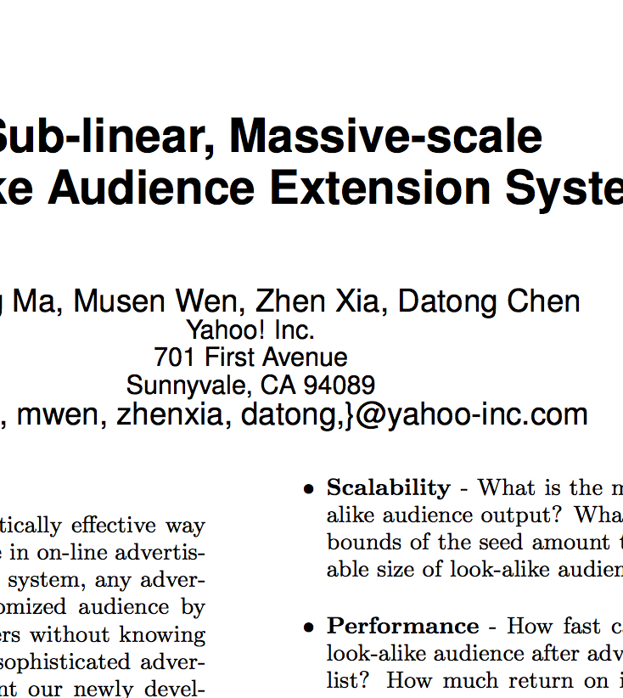
1 class modeling
There’s more to AI than just classification
What if we could do more with less?
Notes:
Understanding the tools may become more crucial. Can’t just focus on the data

Slide 20
What do I worry about?
Are we missing an opportunity to become experts on AI tools?
Will insight come from our data or the techniques we use?

